Slide 1

Predicting employee attrition
By Isabelle Uslu
February 2022

Slide 2
Data research Pipeline
Business
Question
Data Acquisition
Exploratory
Data
Analysis
Building
Models
Model
Comparison & Conclusion
Next steps /
Recommendations

Slide 3
Problem Statement
What is employee attrition?
Reduction of the workforce due to resignations, retirement, sickness, or death
What are some disadvantages of high employee attrition rates?
Cost of re hiring*, lack of knowledgeable employees, decreased overall performance, create a negative image
* Replacing an entry-level employee costs 30% - 40% of their annual salary.
* A mid-level employee 150% of their salary.
* And a highly skilled employee up to 400% of their salary.
What causes employee attrition?
Compensation, over working / stress, recognition, career progression, company culture etc

Slide 4
Business Question
Based on the data that is given to us, can we predict employee attrition using various machine learning models and techniques to reduce costs of attrition?

Slide 5
Data Acquisition – Data explained
Data source : Kaggle
149.999 observations
10 columns : 2 categorical columns + 8 numeric columns
Missing values : None
Additional features : None

Slide 6
data Acquisition – Data explained
Satisfaction level : 0 to 1 – (61% avg)
Last evaluation : 0 to 1 – (71% avg)
Number of project : 2 to 7 – (3.8 avg)
Average monthly hours : 96 to 310 – (201 hrs avg)
Time spent in the company : 2 to 10 – (3.5 yrs avg)
Work accident : 0 to 1 - (14% work accidents)
Left : 0 to 1 – (23% attrition rate)
Promotion last 5 years : 0 to 1 - (2% promotion rate)
Sales : categorical - 10 departments in the company
Salary : categorical – low (49%), medium (43%), high (8%)

Slide 7
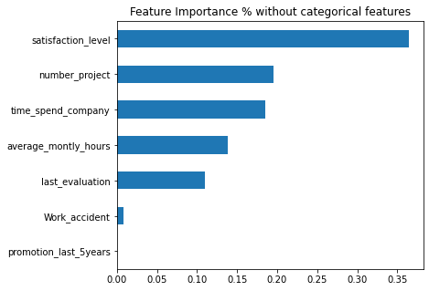
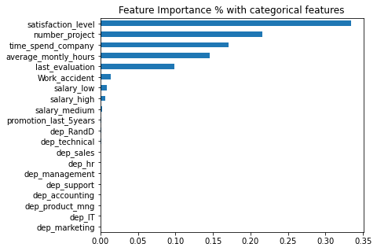
Exploratory data analysis - Visualizing feature importance

Slide 8
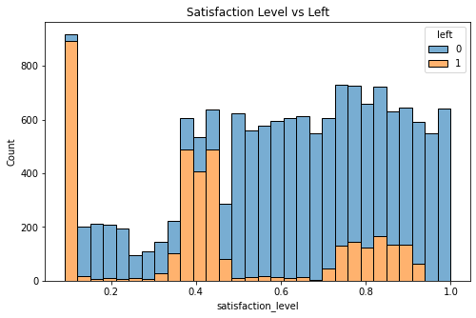
Exploratory data analysis - Satisfaction level and attrition
Lower satisfaction levels – higher attrition
As satisfaction levels get higher attrition gets lower

Slide 9
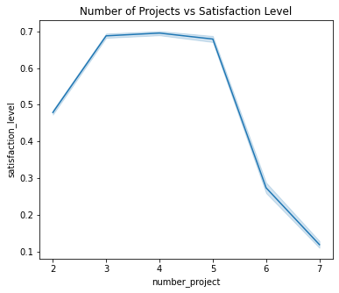
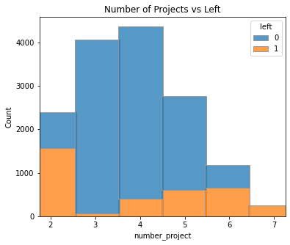
Exploratory data analysis - Number of projects - Satisfaction level - attrition
Satisfaction level drastically decreases after an employee completes 5 projects.
Attrition increases from 4th project.

Slide 10
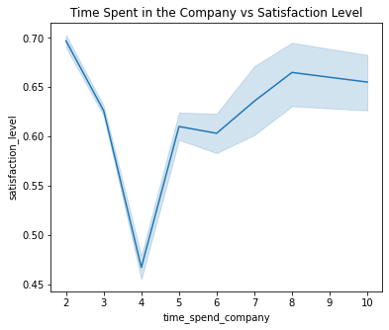
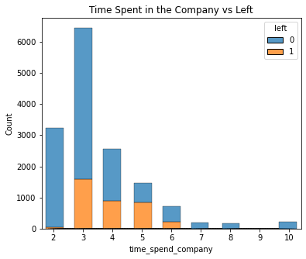
Exploratory data analysis - Number of years - Satisfaction level - attrition
Satisfaction level significantly decreases after an employee spends 3 years in the company.
Most employees are in 3rd year.
Attrition rate is higher at 5th year by 56% - followed by 4th year by 34%.

Slide 11
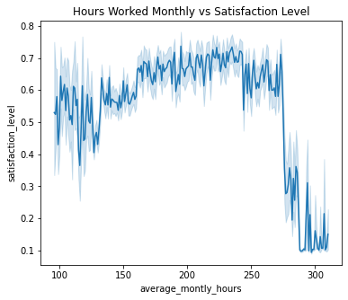
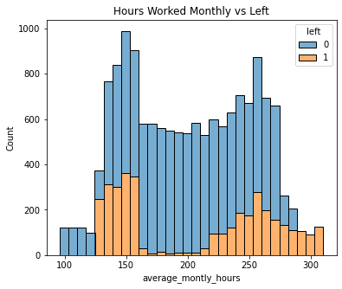
Exploratory data analysis - Monthly work hours - Satisfaction level - Attrition
Satisfaction level has a significant drop after an employee works 270 hours a month.
Attrition is more frequent after an employee works more than 200 hours.

Slide 12
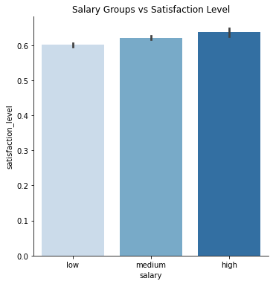
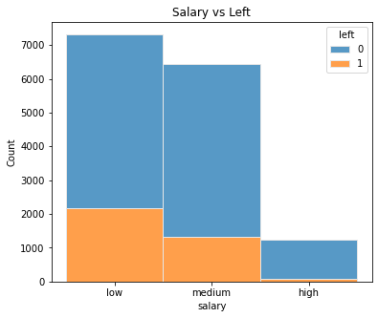
Exploratory data analysis - salary groups - Satisfaction level - attrition
Satisfaction level gets higher as salary increases.
Attrition rate is higher in the low salary group (29%).

Slide 13
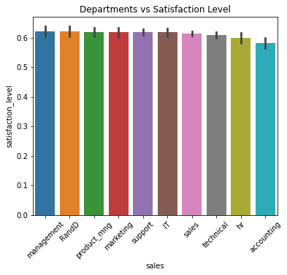
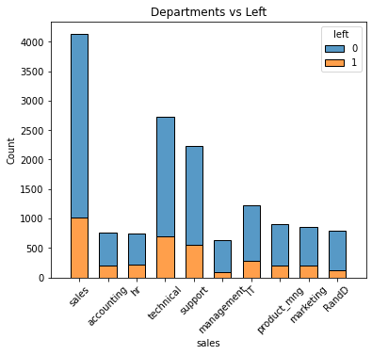
Exploratory data analysis – departments - Satisfaction level – attrition
Satisfaction levels are similar amongst departments.
More people leave from sales department.
HR department has highest percentage of attrition by 30% - followed by accounting 26%

Slide 14
Building Models - Modelling Steps Followed
1. Conducted feature selection by Random Forest.
- Notebook 1 – only with numerical data
- Notebook 2 – included categorical data
2. Created 2 notebooks with selected features
- Notebook 1 – with top 4 features
- Notebook 2 – with top 8 features
3. Defined target value – check any class imbalance issues
4. Due to target’ s class imbalance, oversampled minority class (by SMOTE)

Slide 15
Building Models - Modelling Steps Followed
5. Scaled feature values for in both notebooks due to variance differences
6. Used Logistic Regression, Decision Tree Classifier, Random Forest Classifier and K Nearest Neighbors machine learning models on data. Applied hyperparameter tuning only to Logistic Regression as the scores were significantly lower than the other models.
7. Created precision – recall curves to be able to compare models among each others in both notebooks.
8. Created confusion matrix

Slide 16
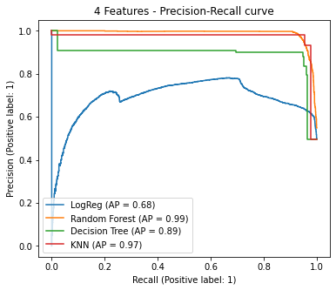
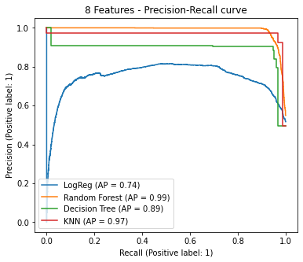
Model comparison
Using 8 features improves Logistic Regression model.
Comparing both approaches – Random Forest is the winner.

Slide 17
Model comparison - Comparing 2 approaches
0 – is still working
1 – left
Recall : from all the positive classes, how many we predicted correctly.
Precision : from all the classes we have predicted as positive, how many are actually positive
4 Feature Approach | Precision | Recall
Class 0 | 0.93 | 0.99
Class 1 | 0.98 | 0.93
8 Feature Approach | Precision | Recall
Class 0 | 0.93 | 0.98
Class 1 | 0.98 | 0.93

Slide 18
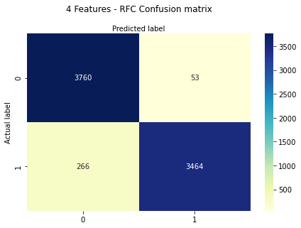

Model comparison & Conclusion Comparing 2 approaches
0 – is still working
1 – left
8 feature approach with Random Forest model predicts slightly better on the class 1.
Future predictions will be done by using Random Forest with 8 features.

Slide 19
Next steps / recommendations
How to motivate employees to reduce attrition?
Offer skill training
Pay competitive
Show appreciation
Give rewards for achievements
Offer employee the option of cross training
Level the workload
Regular review session
Develop exit interview to understand the reasons for staff leaving
Report staff turn over , reasons for leaving and cost on a regular basis to managers.

Slide 20
THANK YOU !
ANY QUESTIONS ?

